Slide 1

6th Grade Math
Unit 7, Lesson 8 Subtracting Integers Using Number Lines Volume 2, pg. 38

Slide 2


Benchmark
MA.6.NSO.4.1
Apply and extend previous understandings of operations with whole numbers to add and subtract integers with procedural fluency.
volume 2, pg. 38

Slide 3
Integrated Mathematical Thinking and Reasoning Standards
MA.K12.MTR.5.1 Use patterns and structure to help understand and connect mathematical concepts.
MA.K12.MTR.6.1 Assess the reasonableness of solutions.
volume 2, pg. 38

Slide 4

Learning Targets
I can subtract integers using a number line.
I can use number lines to understand how the rules for adding integers are related to the rules for subtracting integers.
volume 2, pg. 38

Slide 5

Warm-Up
volume 2, pg. 38

Slide 6
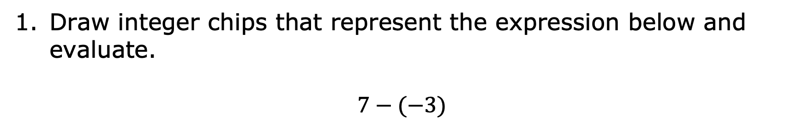
7.8.1 Warm-Up: Bell Work
Draw integer chips that represent the expression below and evaluate.
$$7−(−3)$$
volume 2, pg. 38

Slide 7

Guided Instruction
volume 2, pg. 39

Slide 8

7.8.2 Guided Instruction: Subtracting Integers Using a Number Line
The temperature in degrees Fahrenheit (℉) of a city in Alaska was ${}_{}^{−}4℉$. After sunset, the temperature dropped $6℉$.
Represent the change in temperature on the number line.
Write the subtraction number sentence that is represented from the context and on the number line.
After the decrease in temperature, what was the temperature?
volume 2, pg. 39

Slide 9
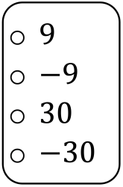
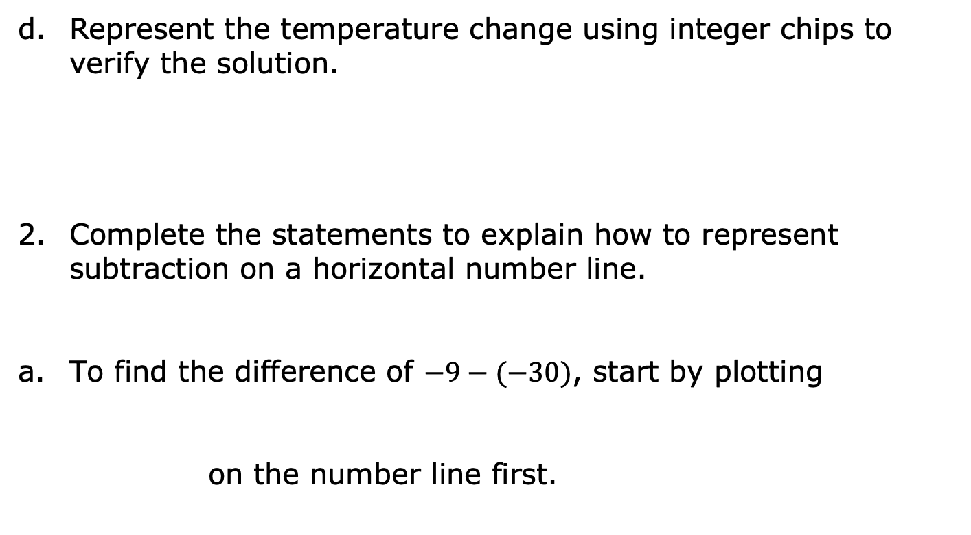
Represent the temperature change using integer chips to verify the solution.
Complete the statements to explain how to represent subtraction on a horizontal number line.
To find the difference of $−9−(−30)$, start by plotting
on the number line first.
volume 2, pg. 39

Slide 10
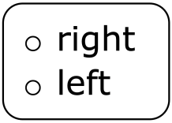
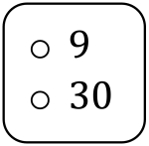
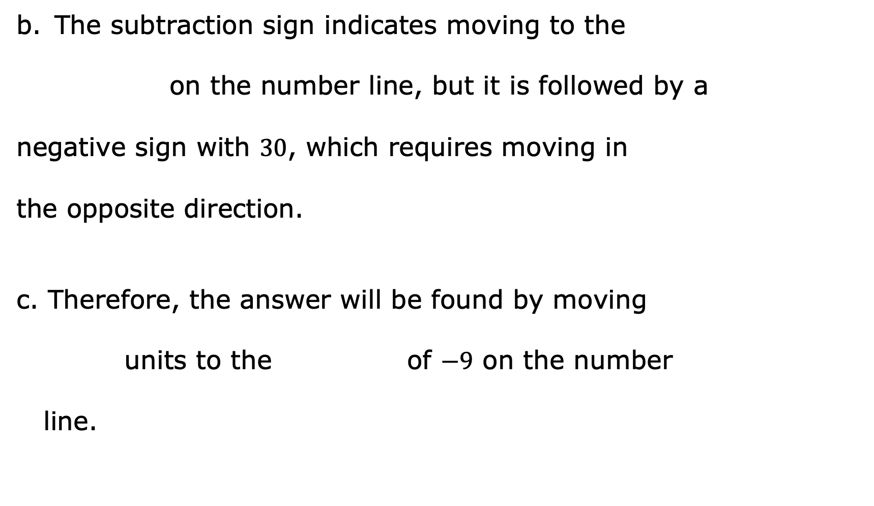
The subtraction sign indicates moving to the
on the number line, but it is followed by a
negative sign with $30$, which requires moving in
the opposite direction.
Therefore, the answer will be found by moving
units to the of $−9$ on the number
line.
volume 2, pg. 39

Slide 11
Show the subtraction on the number line below.
The difference of $−9−(−30)$ is _______.
volume 2, pg. 39

Slide 12

Collaboration
volume 2, pg. 40

Slide 13

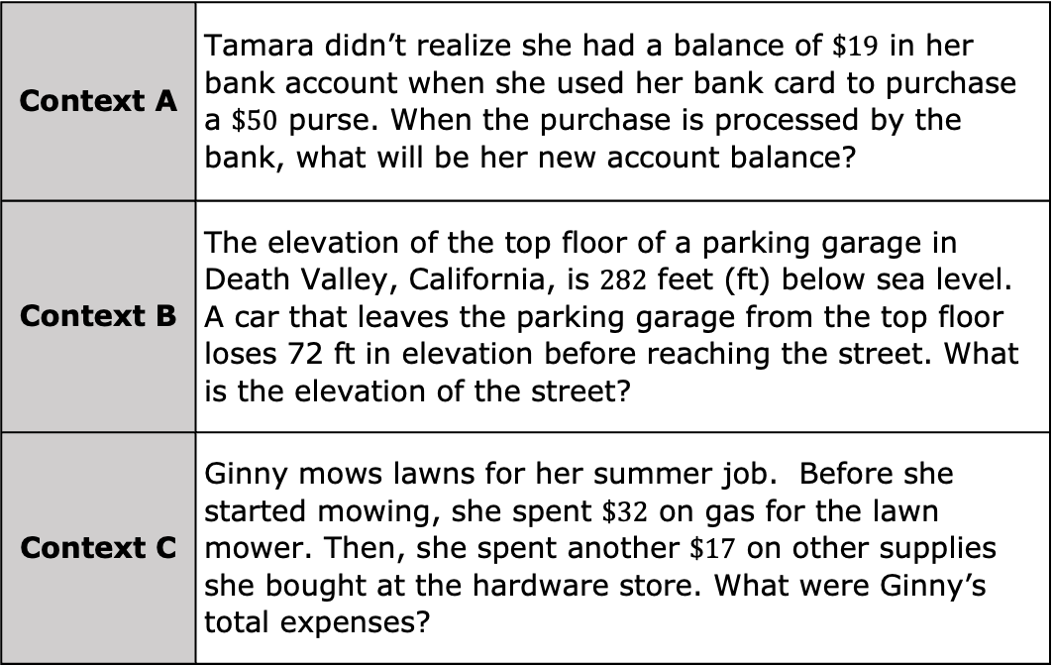
7.8.3 Collaboration: Relating Integer Addition and Subtraction
Three contexts are given below. Choose one context to work on with your partner. Circle your choice.
Context A | Tamara didn’t realize she had a balance of $\$19$ in her bank account when she used her bank card to purchase a $\$50$ purse. When the purchase is processed by the bank, what will be her new account balance?
Context B | The elevation of the top floor of a parking garage in Death Valley, California, is $282$ feet (ft) below sea level. A car that leaves the parking garage from the top floor loses 72 ft in elevation before reaching the street. What is the elevation of the street?
Context C | Ginny mows lawns for her summer job. Before she started mowing, she spent $\$32$ on gas for the lawn mower. Then, she spent another $\$17$ on other supplies she bought at the hardware store. What were Ginny’s total expenses?
volume 2, pg. 40

Slide 14
For the context selected, represent the mathematics in the context in each of the following ways.
Draw a number line to represent the given context.
Write two equations that can be used to find the solution to the question in the context. One equation should use subtraction and the other should use addition.
volume 2, pg. 40

Slide 15
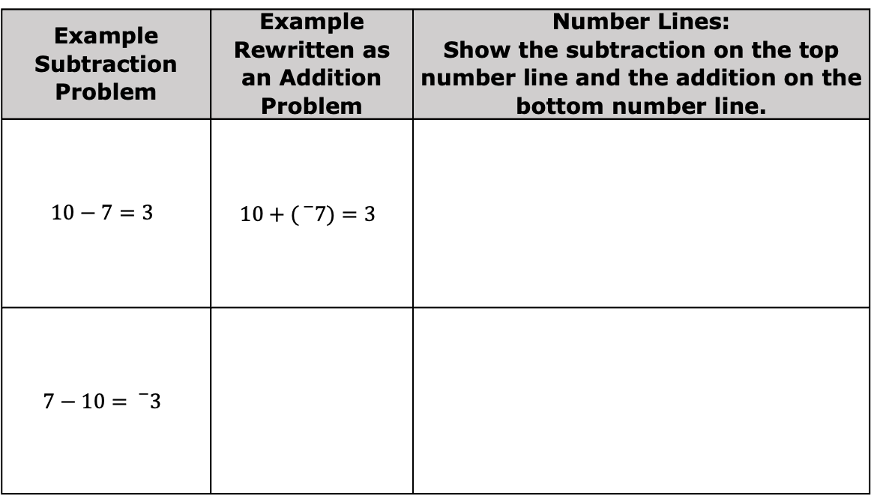
Create a group of four by joining with another pair of students. Verify your work by exchanging with the other pair of students.
Continue working with the group of four to complete the table.
Example Subtraction Problem | Example Rewritten as an Addition Problem | Number Lines: Show the subtraction on the top number line and the addition on the bottom number line.
$$10−7=3$$ | $$10+({}_{}^{−}7)=3$$
$$7−10={}_{}^{−}3$$
volume 2, pg. 40

Slide 16
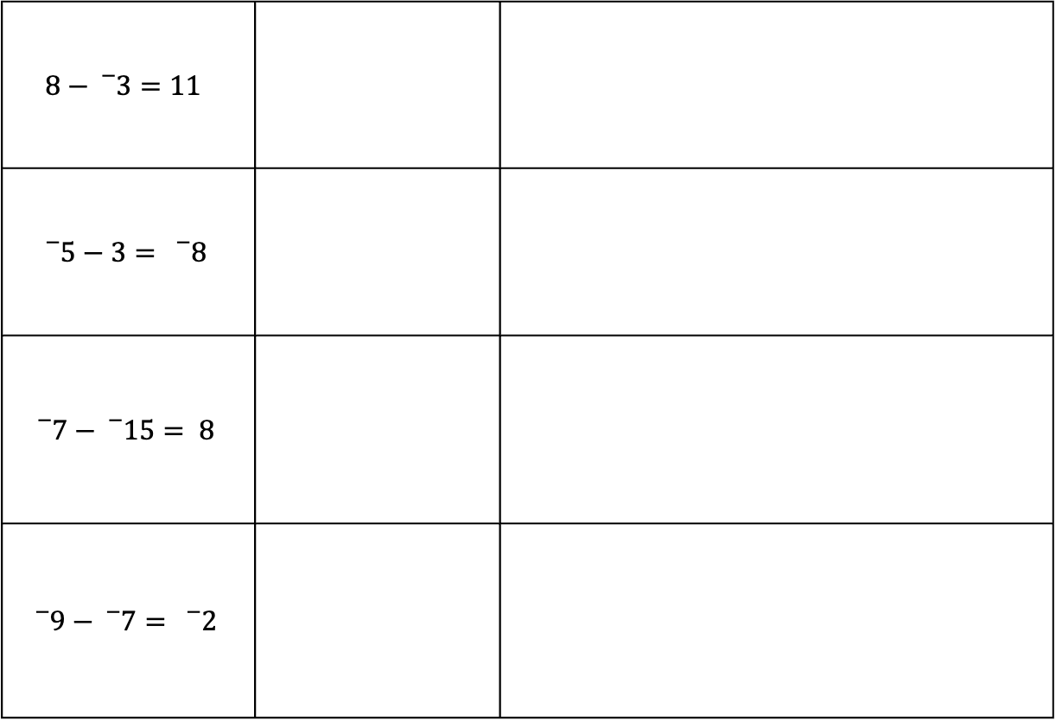
$$8−{}_{}^{−}3=11$$
$${}_{}^{−}5−3= {}_{}^{−}8$$
$${}_{}^{−}7−{}_{}^{−}{15}= 8$$
$${}_{}^{−}9−{}_{}^{−}7= {}_{}^{−}2$$
volume 2, pg. 41

Slide 17
When subtracting integers, problems can be rewritten as an addition problem using the additive inverse of the second integer.
Describe one advantage of changing a subtraction problem to an addition problem.
volume 2, pg. 41

Slide 18
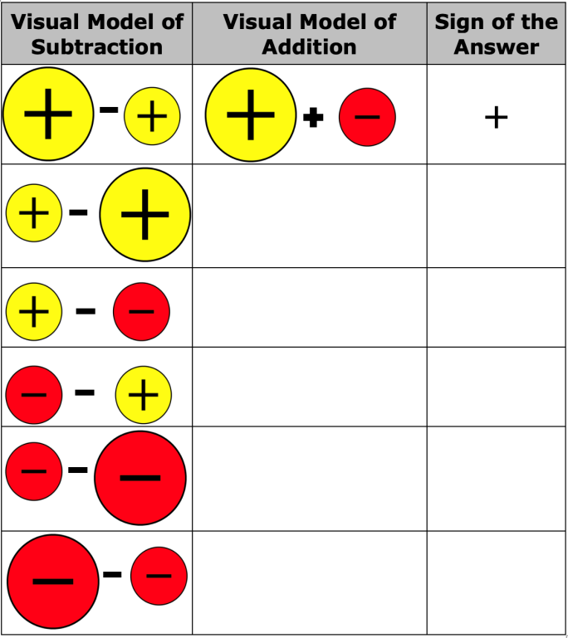
Complete the table by rewriting the second integer in the subtraction model as its additive inverse and indicating the sign of the value of either expression. The first row has been completed. Once your group is done, split back into pairs and check your table with a different pair of students.
volume 2, pg. 41

Slide 19

Your Turn
volume 2, pg. 42

Slide 20

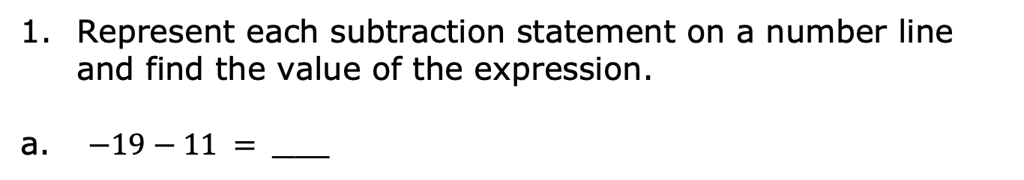
7.8.4 Your Turn!
Represent each subtraction statement on a number line and find the value of the expression.
$−19−11 = _____$
$12−(−28) = _____$
$(−14)−(−15) = _____$
volume 2, pg. 42

Slide 21

Wrap-Up
volume 2, pg. 42

Slide 22
7.8.5 Wrap-Up: Reflection
Draw an X on each line to indicate where your current learning is related to each target.
I can subtract integers using a number line.
I need help. I can’t get started. | I’m getting there, but I need more practice. | I understand this, and I feel confident.
I can use number lines to understand how the rules for adding integers are related to the rules for subtracting integers.
I need help. I can’t get started. | I’m getting there, but I need more practice. | I understand this, and I feel confident.
volume 2, pg. 42

